Slide 1
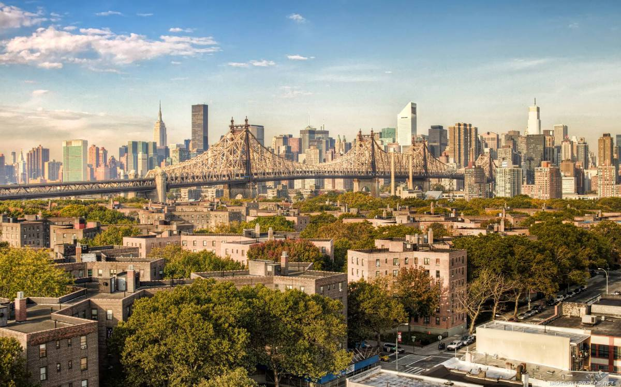
New Asian Recreational Food Hall Location & Venues
Data Analysis of Queens

Slide 2
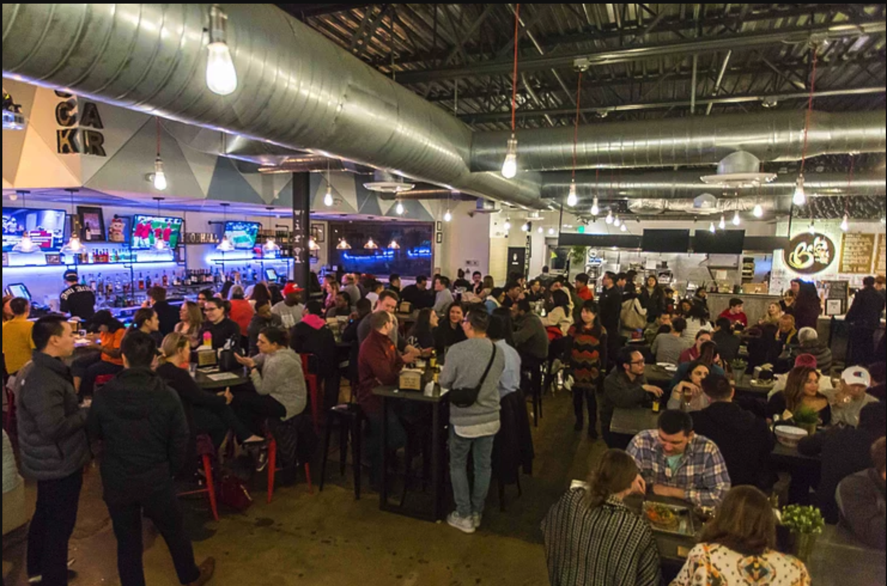
Business Idea
The food hall will have individual food, dessert, and beverage concepts, a spacious seating area, and a casual lounge. As its name suggests, the venue is meant to emulate the atmosphere of a neighborhood recreational location.
Asian-focused hub. After witnessing the growing popularity of Asian bubble tea culture. Our investors thought a food hall as the next project. The idea is to create a recreational food hall in Queens, NY.
Photos by Google Search

Slide 3
The data I used in this project is obtained from https://geo.nyu.edu/catalog/nyu_2451_34572. It contains the data of all the neighborhoods and boroughs in New York City. It belongs to New York University Spatial Data Repository. The dataset is free and downloaded to the server.
Data

Slide 4
Techniques used in this project includes:
Web scrapping using Beautiful Soup
Foursquare API
Data Visualization using Folium
Data manipulation using numpy and pandas
Clustering using K-Means

Slide 5
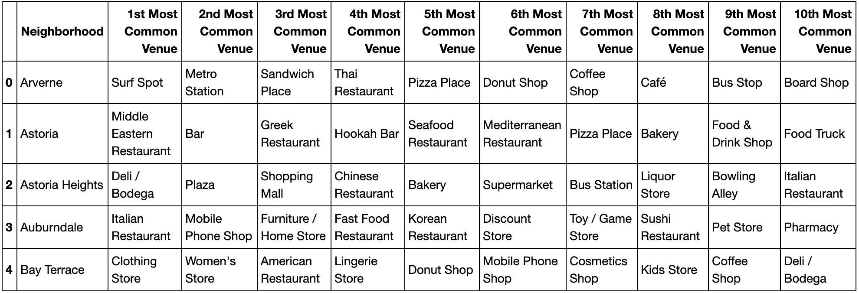
Using the Foursquare API and then I cleaned the json and structure it into pandas data frame. 100 venues were returned by Foursquare.
Methodology
Creating the new data frame and display the top 10 venues for each neighborhood.

Slide 6
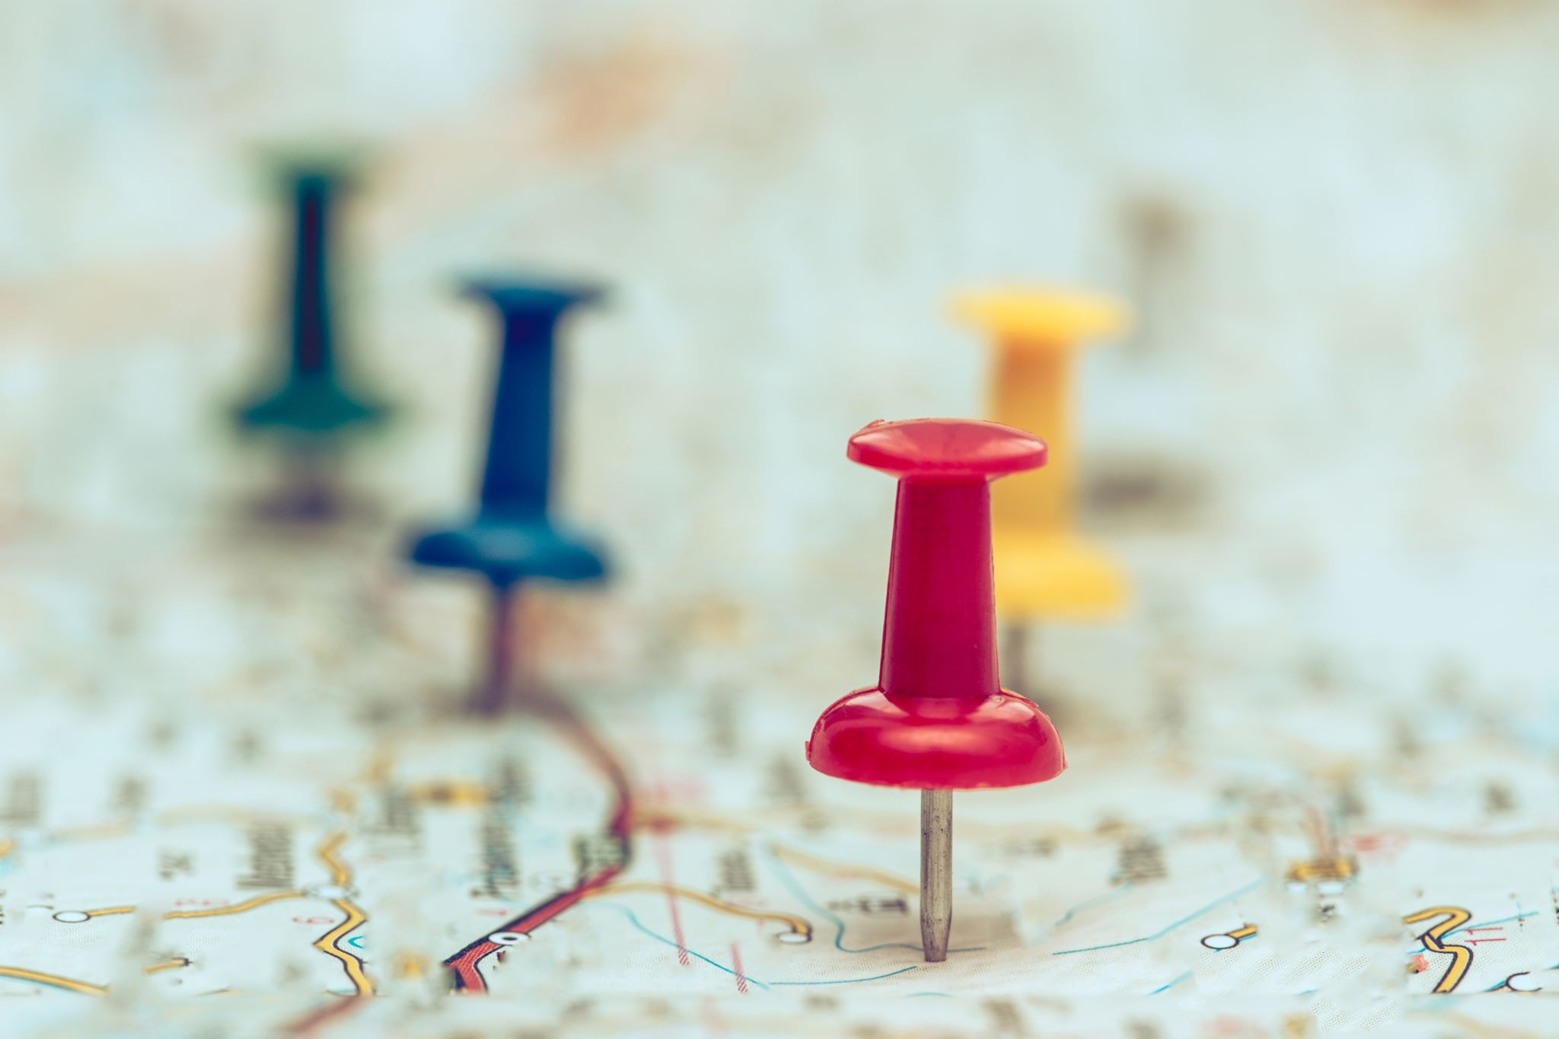
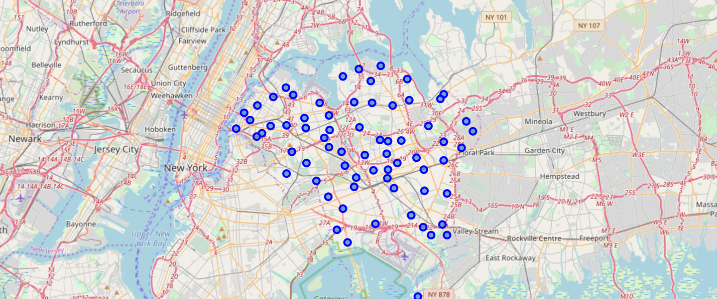
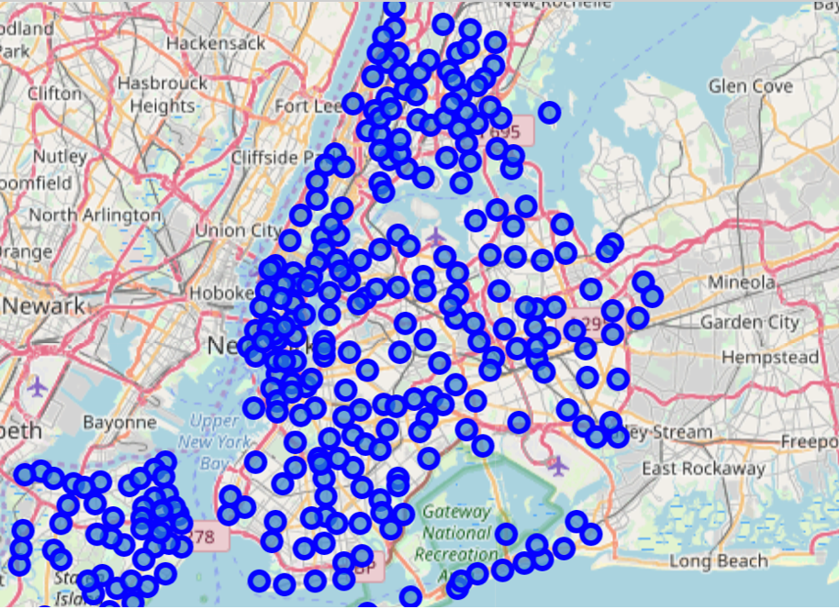
Lower left: Map of New York with neighborhood superimposed on top Upper right: Map of Queens with neighborhood superimposed on top

Slide 7
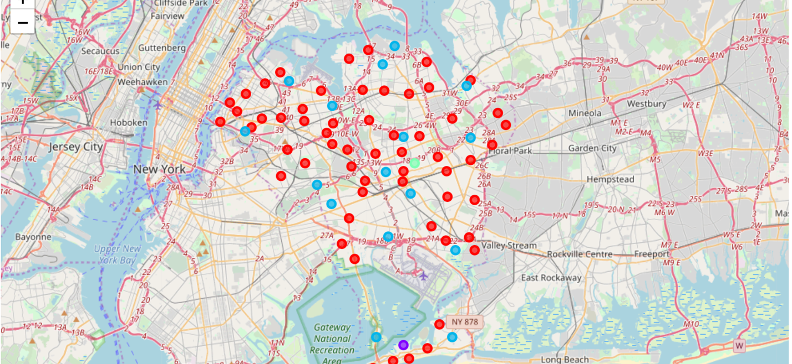
How to get the results?
Results
Ran K-means to cluster the neighborhood into 5 clusters.
Created a new data frame that includes the cluster as well as the top 10 venues for each neighborhood in Queens.
Use folium to visualize the resulting clusters.
Cluster 1 (label 0 red)
Cluster 2 (label 1 purple)
Cluster 3 (label 2 blue)
Cluster 4 (label 3 light green)
Cluster 5 (label 4 orange)

Slide 8
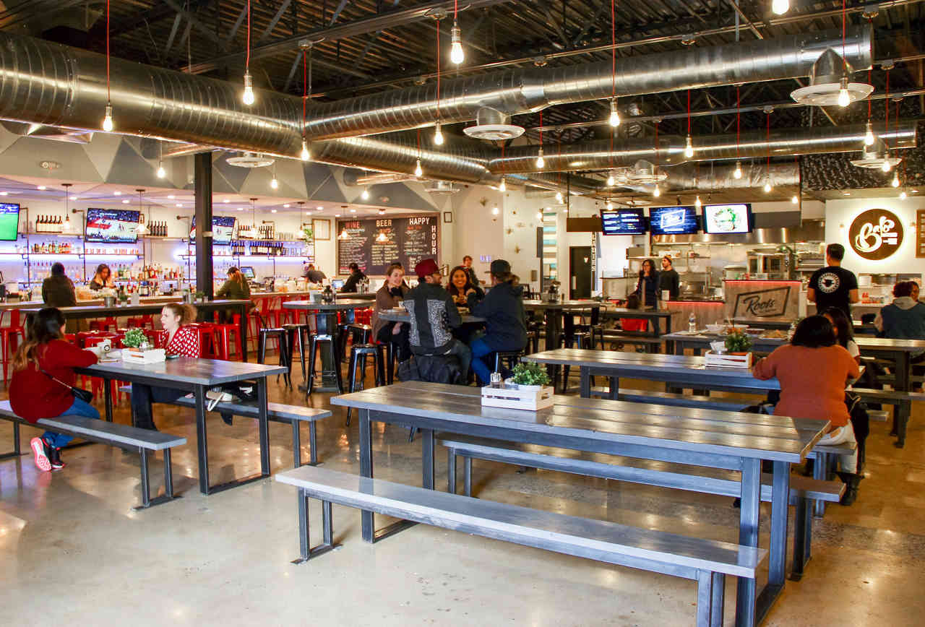
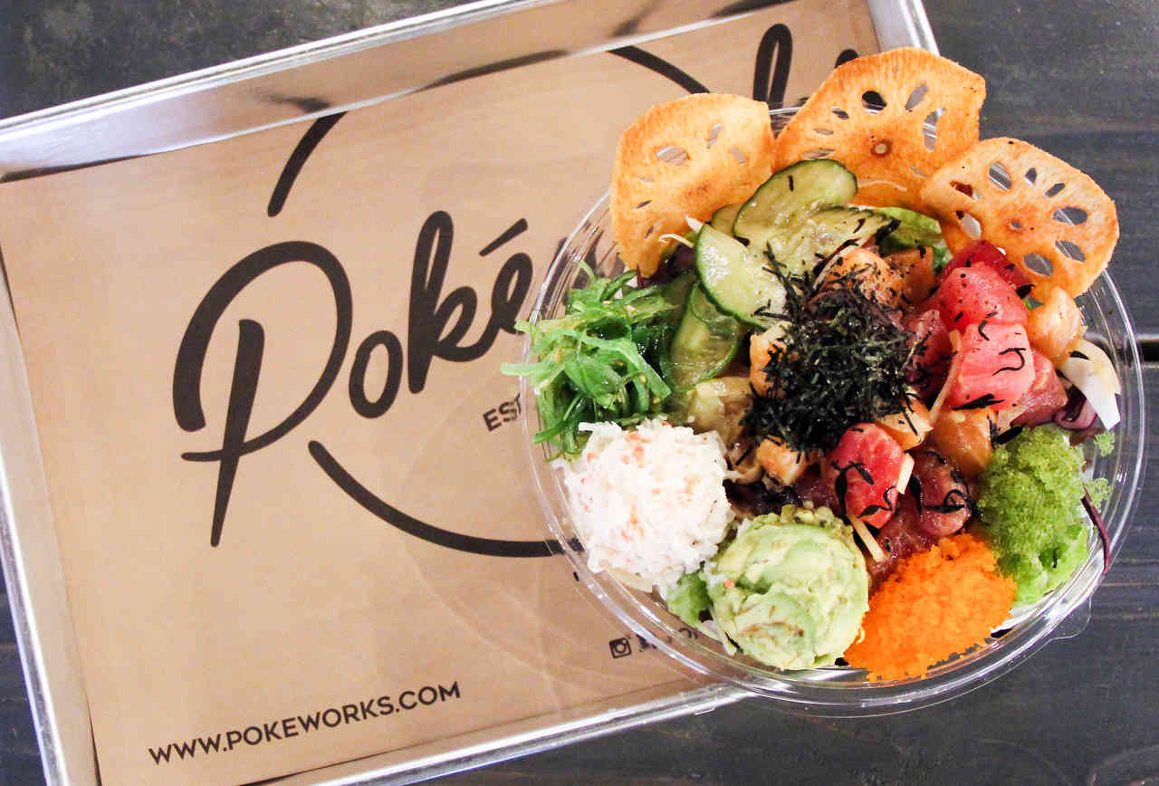
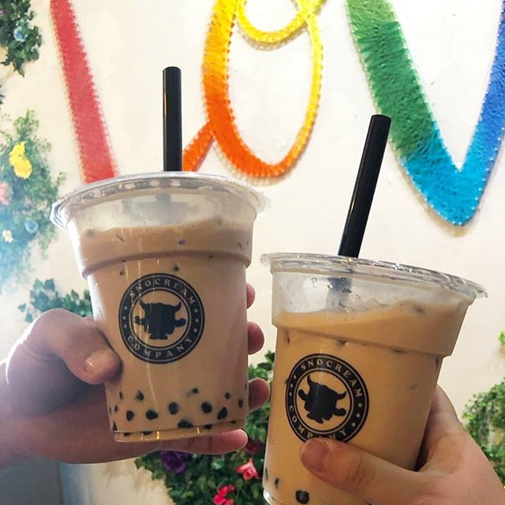
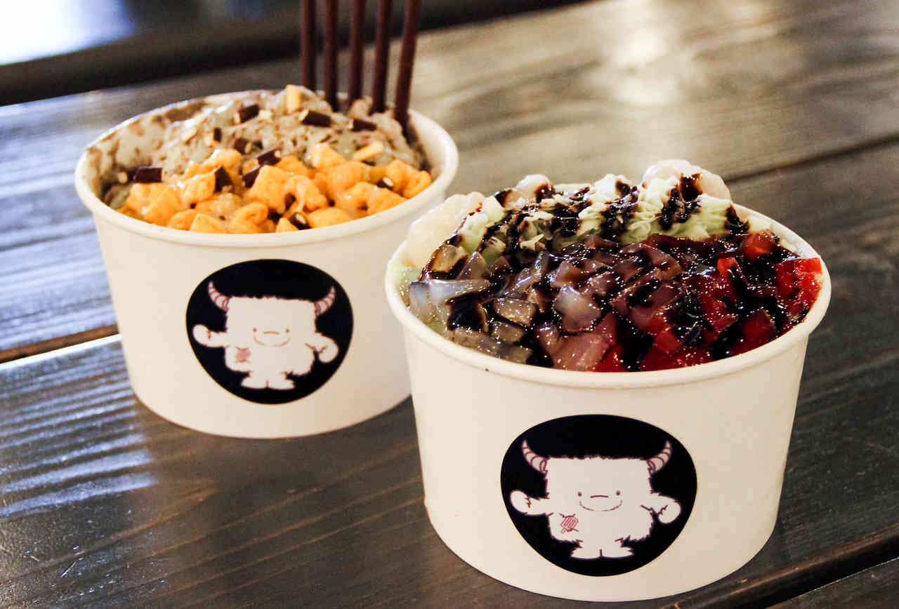
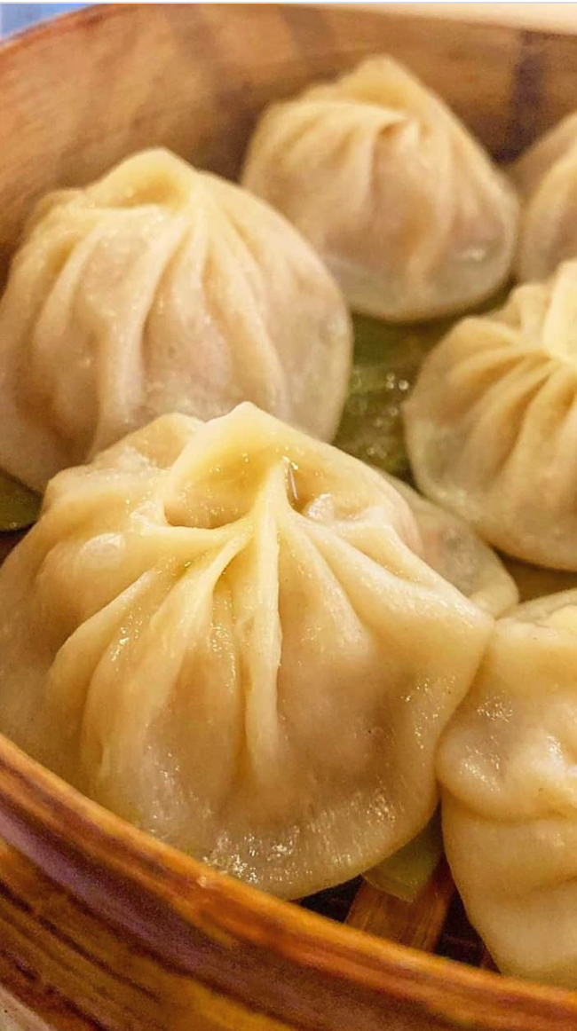
The neighborhood in Queens has the most bubble tea shops is Flushing. The second highest common venue for bubble tea shop is Whitestone. However, Flushing is in cluster 1(cluster label 0 red color) commercial area, Whitestone is in cluster 3(cluster label 2 blue color) residential area. What we are looking for is a commercial oriented neighborhood. Therefore, our new Asian recreational food hall should be placed in Flushing since it is a neighborhood which has most of the customers who are the same targeted customers of bubble tea shops.
Flushing,Queens
Wins!
Conclusion:
Photos by Google Search

